Slide 1
Chapter 4
BOND MARKETS

Slide 2
Chapter outline
1. Overview of the bond market
2. Key characteristics of bonds
3. Bond valuation
4. Interest rate risk of bonds
5. Other risks of bonds

Slide 3
References
Mishkin & Easkin, Financial Markets + Institutions, Chapter 9
Berk DeMarzo, Corporate Finance, Chapter 6 + Chapter 30
Madura , Financial Institutions & Market, 9th Chapter 7
CFAI 2016 Level 1 Volume 5- Equity and Fixed Income

Slide 4
1. Overview of the bond market (Self-study)
Bonds: represent a debt owed by the issuer to the investor; obligate the issuer to pay specified amounts at given dates. Types: coupon bond, zero-coupon bond, step-up note, floating-rate bond.
Primary market trading: uniform-price auction, multi-price auction, competitive auction, non-competitive auction, syndication, underwriting, tap sales, private placement.
Secondary market trading: spot trade, repo,…
(Refer: Mishkin 7th Chapter 12, Madura 9th Chapter 7, CFAI 2012 Level 1 Volume 5 SS15)

Slide 5
Key Characteristics of Bonds
Par value: face amount; paid at maturity. Normally in denominations of $1,000.
Coupon interest rate: stated annual interest rate on a bond. Multiply by par value to get the annual interest payment (coupon payment). Most bonds have fixed coupon rate.

Slide 6
Special Types of Bonds
Zero coupon bond: a bond that pays no annual interest; it provides compensation to investors in the form of capital appreciation.
Floating rate bond: a bond whose coupon rate fluctuates with shifts in the general level of interest rates.

Slide 7
Key Characteristics of Bonds
Maturity date: a specified date on which the par value is repaid.
Term to maturity: the length of time until maturity date.
Payment pattern: the frequency of the interest payments. Most bonds in the U.S. pay interest semiannually.

Slide 8
Key Characteristics of Bonds
Bond ratings: ratings on corporate bonds that provide an indication of default risk.
Current yield: the ratio of the annual interest payment to the bond’s market price.

Slide 9
Yield-to-Maturity
Yield to maturity (YTM): the rate of return earned on a bond held to maturity.
It is the discount rate that equates the present value of the future cash flows with the current market price of the bond.

Slide 10
Yield-to-Maturity
Represents investor’s total return from settlement day until security expiration
Allows investors to compare bonds with different maturities and coupon rates via internal rate of return calculations
Bond yields inversely related to bond prices
Common maturities:
short term: up to five years
medium term: 5-12 years
long term: 12 or more years

Slide 11
Government Bonds
Low risk, high liquidity, low interest rate.
Treasury notes, bonds.
Municipal bonds.
Treasury Inflation-Indexed bonds.
Strips (Treasury Separate Trading of Registered Interest and Principal Securities).
(Refer: Mishkin 7th Chapter 12, Madura 9th Chapter 7, CFAI 2012 Level 1 Volume 5 SS15)

Slide 12
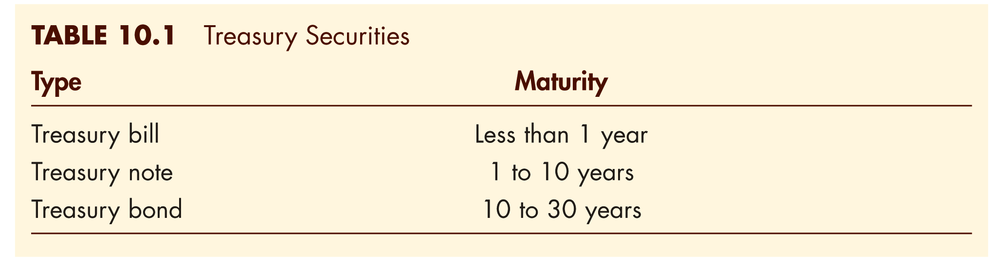
Treasury Notes and Bonds

Slide 13
Case : Shareholders VS Debtholders
Phương Xuân Limited Liability Company has a debt of 100 bil. on the balance sheet payable in one year. Value of all asset is now 80 bil.
There is one investment opportunity available: Initial investment 50 bil. In one year there is a probability of 30% that the return is 100 bil (win). and 70% that the return is 0 (fail).
Phương Xuân is the only owner and manager of the company. Phương Xuân owns a house whose value is 10 bil.. She also has a 10 bil bank deposit.

Slide 14
Case : Shareholders VS Debtholders
If Phuong Xuan decides not to invest. In one year, the value to Phuong Xuan and debtholders will be:
a/ 80 bil and 20 bil b/ 100 bil and 0 bil
c/ Other
2. If Phuong Xuan decides to invest and fail, in one year the value to Phuong Xuan and debtholders will be:
a/ 100 bil and 0 bil b/ 80 bil and 20 bil
c/ 50 bil and 0 bil d/ Other

Slide 15
Case : Shareholders VS Debtholders
3. If Phuong Xuan decides to invest and win. In one year, the value to Phuong Xuan and debtholders will be:
a/ 100 bil and 0 bil b/ 80 bil and 20 bil
c/ 100 bil and 50 bil d/ Other
4. If you were Phuong Xuan, what would you do?
a/ Invest b/ Do not invest
c/ Go America d/ Other

Slide 16
Corporate Bonds:
Characteristics of Corporate Bonds:
Bearer/ Registered Bonds/Indenture
Sinking-Fund Provision.
Restrictive Covenants.
Call Provisions.
Bond Collateral.
Variable Rate Bonds.
Convertibility.
Junk bonds

Slide 17
Characteristics of Corporate Bonds
Bearer bonds
Payments were made to whoever had physical possession of the bonds. Bonds were sold with attached coupons. The owners of the bonds clipped and mailed the coupons to the firm to receive payment
Registered Bonds
Replaced “bearer” bonds.
Do not have coupons
The owners register with the firm to receive interest payment.
IRS can track interest income this way
Bond Indenture/ Trust Deed
- A legal contract that describes the form of the bond, the obligations of the issuer and the right of the holders.

Slide 18
Characteristics of Corporate Bonds
Restrictive Covenants
Included in bond indenture (khế ước trái phiếu)
Rules and restrictions on managers designed to protect the bondholders’ interest.
May limit dividends, new debt, ratios, financial policies, etc.
Interest rate will be lower for more restrictive conditions because the bonds will be considered safer by buyers.

Slide 19
Characteristics of Corporate Bonds
Collaterals
Assets or financial guarantees underlying the debt obligations and beyond the issuer’s promise to pay.
Credit enhancements
- A variety of provisions that can be used to reduce the credit risk of a bond issue.
Internal credit enhancements
External credit enhancements
(Ref: CFA-level 1-B5-Equity and Fixed Income-p. 306)

Slide 20
Characteristics of Corporate Bonds
Call provisions
The issuer has the right to force the bond holders to sell the bond back. → Callable bond
Most corporate indentures include a call provision.
If interest rates fall enough, the price will rise above the call price, and the firm will call the bond.
Call provisions put a limit on the amount that bondholders can earn from the appreciation of a bond’s price→ Investors do not like call provisions.

Slide 21
Characteristics of Corporate Bonds
Sinking fund
A requirement in the bond indenture that the firm pay off a portion of the bond issue each year.
Funds set aside by the issuer to ensure the firm is able to redeem the bond at maturity.
Reduce the probability of default when the issue mature.

Slide 22
Characteristics of Corporate Bonds
Conversion
The bond can be converted into certain number of common shares at the discretion of the bondholder → Convertible bond
Similar to a stock option, but usually more limited.
Issuing convertible bonds is one way that firms avoid sending negative signal to the market (if managers believe that the firm will perform well in the future, they can issue convertible bonds. If the managers are correct and the stock price rises, the bondholders will convert to stocks. Alternatively, bondholders have the option not to convert if managers turn out to be wrong).

Slide 23
Characteristics of Corporate Bonds
Junk Bonds
Debt that is rated below BBB
Often, trusts and insurance companies are not permitted to invest in junk debt
Michael Milken developed this market in the mid-1980s, although he was convicted of insider trading

Slide 24
Corporate Bonds: Debt Ratings
The next slide explains in further details the rating scale for corporate debt. The rating scale is for Moody’s. Both Standard and Poor’s and Fitch have similar debt rating scales.

Slide 25
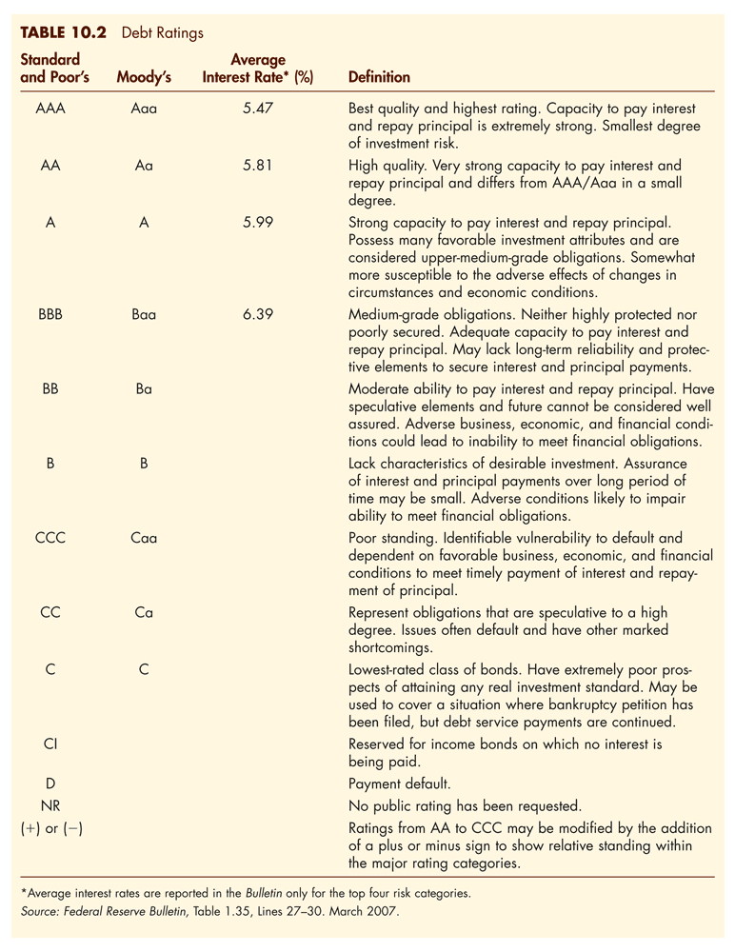
Corporate Bonds: Debt Ratings

Slide 26
3. Bond valuation
Bond valuation
Dynamics Behavior of Bond Prices
Notes:
Lec 1

Slide 27
Cash Flow Pattern of a Bond
0
1
2
3
4
n
Purchase Price
Coupon
Coupon
Coupon
Coupon
Coupon +
Face Value
Cash Outflows to the Investor
Cash Inflows to the Investor
The Purchase Price or Market Price of a bond is simply the present value of the cash inflows, discounted at the bond’s yield-to-maturity

Slide 28
Bond Valuation
The value of a bond is a function of:
Par value
Term to maturity
Coupon rate
Investor’s required rate of return (discount rate is also known as the bond’s yield to maturity)

Slide 29
Bond valuation
Annual coupon bond
Semiannual coupon bond

Slide 30
Bond valuation
Zero-coupon bond

Slide 31
Problem 1
What is the market price of a ten-year, $1,000 bond with a 5% coupon, if the bond’s yield-to-maturity is 6%?
What is the market price of a ten-year, $1,000 semiannual coupon bond with a 5% coupon, if the bond’s yield-to-maturity is 6%?

Slide 32
Conventions for Quotes and Calculations
When investors purchase shares, they pay quoted price.
For bonds, however, there can be a difference between the quoted price and the price paid.
Full Price = Flat price + Accrued Interest.
The flat price is called the quoted or “clean” price.
The full price is called the invoice or “dirty” price.

Slide 33
Flat price, Accrued Interest and Full Price
The flat price usually quoted by dealers.
If a trade takes places, the accrued interest is added to the flat price to obtain the full price paid by the buyer and received by the seller on the settlement date.
The settlement date is when the bond buyer makes cash payment and the bond seller deliver securities.
To avoid misleading investors about the market price trend for the bond.

Slide 34
Accrued Interest
Accrued interest is the proportional share of the next coupon payment. Assume that the coupon period has T days between payments dates and that t days have gone by since the last payment. The accrued interest: AI= t/T * PMT.
The AI part of the full price does not depend on the YTM.
The two most common day-count conventions are actual/actual and 30/360.

Slide 35
Accrued Interest
For example, a semiannual coupon bonds pays interest on 15 May and 15 November. Settlement date= 27 June.
The actual/actual day- count convention t= 43, T=184
The 30/360 count convention t= 15+27=42, T=180

Slide 36
Example

Slide 37
Example

Slide 38
Dynamics Behavior of Bond Prices
Factors Affecting Bond Prices
Time and bond prices
Interest rate changes and bond prices → Interest rate sensitivity
(Ref: Ch6, Valuing bonds, Corporate Finance, Berg DeMarzo)

Slide 39
Factors Affecting Bond Prices
The relationship between the coupon rate and the bond’s yield-to-maturity (YTM) determines if the bond will sell at a premium, at a discount, or at par
If | Then | Bond Sells at a:
Coupon < YTM | Market < Face | Discount
Coupon = YTM | Market = Face | Par
Coupon > YTM | Market > Face | Premium

Slide 40
Problem 2
Consider a 30-year zero-coupon bond with a YTM of 5% and a $100 face value. What is the initial price of this bond? If the YTM remains at 5%, what is the price of the bond 5 years later? What is the annual return if coupon rate is 7%?
→ If a bond’s YTM has not changed, the annual return of an investment in the bond equals to its YTM even if you sell the bond early.

Slide 41
Problem 3
Consider a 30-year bond with a 10% coupon rate (annual payment) and a $100 face value. What is the initial price of this bond if it has a 5% YTM? If the YTM is unchanged, what will the price be immediately before and after the first coupon is paid?

Slide 42
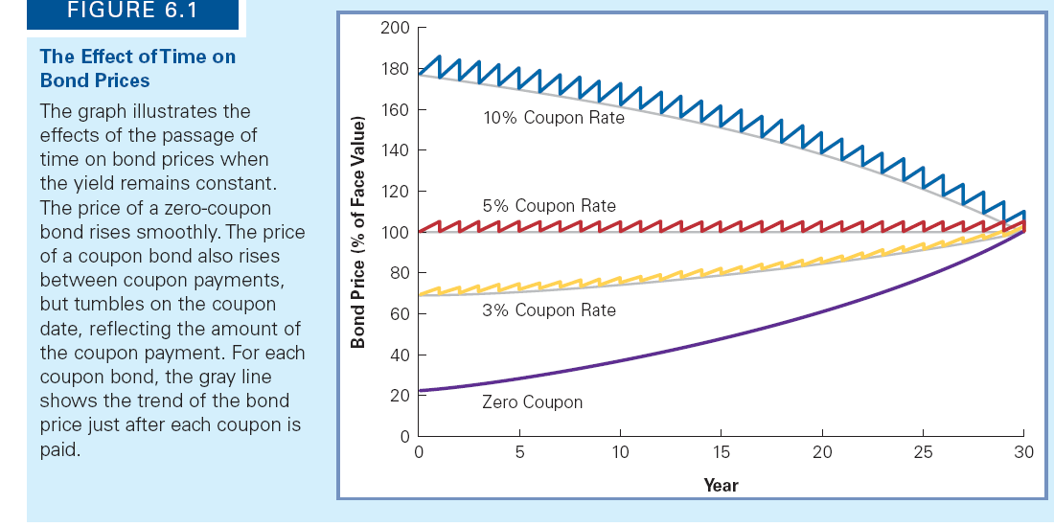
The effect of time on bond prices

Slide 43
Problem 4
Consider a 15-year zero-coupon bond and a 30-year coupon bond with 10% annual coupons. By what percentage will the price of each bond change if its YTM increases from 5% to 6%?

Slide 44
Some findings
Bond prices are subject to the effects of both the passage of time and the changes in interest rates.
Bond prices converge to the bond’s face value due to the time effect, but simultaneously move up and down due to unpredictable changes in bond yields.

Slide 45
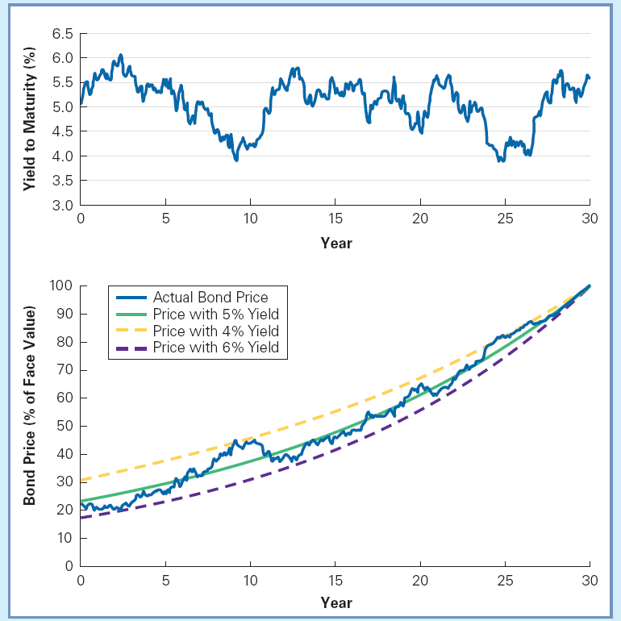
YTM and bond price fluctuations over time

Slide 46
Example
Table 15.3 | An Illustration of Interest-rate Risk for Treasury Securities With a 6% Coupon Selling at Par of $1,000
 |  | Term to | Decline in bond value following |  |  |  | Rise in bond value following
 |  | Maturity | an increase in rates |  |  |  | a decrease in rates
Bond Type |  | (years) | 1% | 2% | 3% |  | -1% | -2% | -3%
Treasury bill |  | Six months | 0% | 0% | 0% |  | 0% | 0% | 0%
Treasury note |  | 2 | -1.84% | -3.63% | -5.38% |  | 1.88% | 3.81% | 5.78%
Treasury note |  | 5 | -4.16% | -8.11% | -11.87% |  | 4.38% | 8.98% | 13.83%
Treasury bond |  | 10 | -7.11% | -13.59% | -19.51% |  | 7.79% | 16.35% | 25.75%
Treasury bond |  | 20 | -10.68% | -19.79% | -27.60% |  | 12.55% | 27.36% | 44.87%
Treasury bond |  | 30 | -12.47% | -22.62% | -30.96% |  | 15.45% | 34.76% | 59.07%

Slide 47
Interest rate sensitivity and maturity
Bond prices are sensitive to the market interest rate
If interest rates rise, the market value of bonds fall in order to compete with newly issued bonds with higher coupon rates.
Sensitivity to the interest rate chance become more severe for longer term bonds.
Percentage rise in price is not symmetric with percentage decline

Slide 48
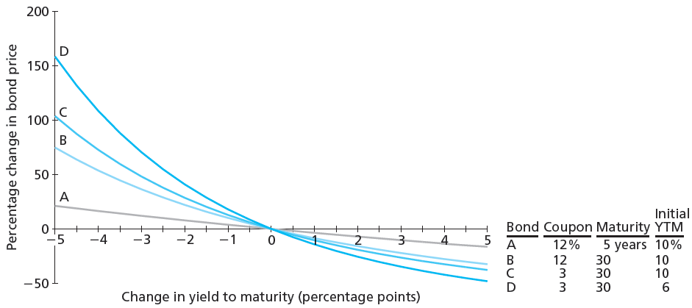
Change in Bond Price as a Function of YTM

Slide 49
Sensitivity and coupon/YTM
Bonds with identical maturities will respond differently to interest rate changes when the coupons differ. → Sensitivity is inversely related to bond’s coupon rate
Sensitivity is inversely related to the current level of the yield to maturity
Explained by analyzing the duration later
※ In summary, the magnitude of the sensitivity or interest rate risk is affected by the maturity, coupon rate, and yield to maturity of bonds

Slide 50
An investor is considering the following six annual coupon payment government bonds:
Bond | Coupon rate | Time-to-Maturity | Yield-to-Maturity
A | 0% | 2 years | 5%
B | 5% | 2 years | 5%
C | 8% | 2 years | 5%
D | 0% | 4 years | 5%
E | 5% | 4 years | 5%
F | 8% | 4 years | 5%
A. Based on the relationship between bond prices and bond characteristics, which bond will go up in price the most on a percentage basis if all yields go down from 5% to 4.9%?
B. Based on the relationships between the bond prices and bond characteristics, which bond will go down in price the least on a percentage basis if all yields go up from 5% to 5.1%?

Slide 51
Interest rate risk
Interest rate risk/sensitivity = Duration.
Longer maturity ~ greater duration.
Higher coupon rate ~ lower duration.
Higher market rate/YTM ~ lower duration.
Notes:
LEC2

Slide 52
Duration
Taylor Series: Bond Price Function Application
Approximation using first derivative (applied to Duration calculation):
⬄

Slide 53
Duration
Taylor Series: Bond Price Function Application
Approximation using first and second derivatives (applied to convexity calculation):
Divided by P:
Duration Convexity

Slide 54
Duration
Duration: A Traditional Mathematical Definition

Slide 55
Duration
A Traditional Mathematical Definition
{Big bracket*1/P} is called Macaulay Duration: present-value weighted average maturity of cash-flow.
Modified Duration (more precise).

Slide 56
Duration
A security’s duration is computed as:
Where C_{t} is the cash flow on date t, PV(C_{t} ) is its present value (evaluated at the bond’s yield), and P=Σ_{t}PV(C_{t} ) is the total present value of the cash flows
Therefore, the duration weights each maturity t by the percentage contribution of its cash flow to the total present value, PV(C_{t} ) ∕ P.

Slide 57
Duration
Duration: A Traditional Mathematical Definition
%Price change = - MD/(1+y)*change in y*100
Modified Duration = MD/(1+y)
%Price change = -MoD *change in y*100

Slide 58
Interpretation of duration
The duration of a bond is a linear approximation of minus the percent change in its price given a 100 basis point change in interest rates. (100 basis points = 1% = 0.01)
For example, a bond with a duration of 7 will gain about 7% in value if interest rates fall 100 bp.

Slide 59
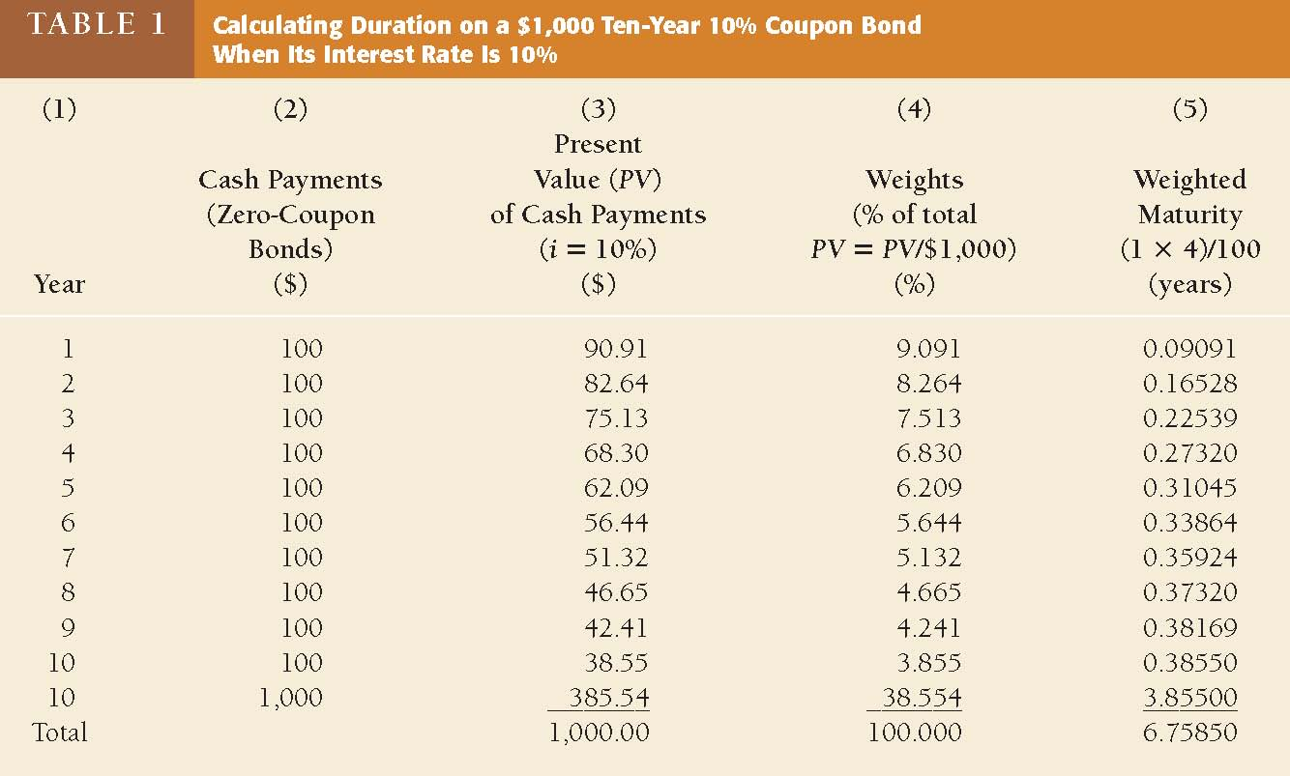
Calculating duration

Slide 60
Example
The duration for a 10% coupon bond is 6.758 years when the interest rate is 10%. Find the approximate change in the bond price when the interest rate increases from 10% to 11%.
%Price change = - MD/(1+y)*change in y*100
= -6.758/1.1*0.01 *100

Slide 61
Calculating duration
Maturity | Coupon rate | Interest rate | Duration
10 | 0.1 | 0.1 | 6.759
10 | 0.08 | 0.1 | 7.044
10 | 0.1 | 0.06 | 7.169
10 | 0 | 0.1 | 10
11 | 0.1 | 0.1 | 7.145

Slide 62
Features of Duration
All else being equal, the longer the term to maturity of a bond, the longer its duration.
All else being equal, when interest rates rise, the duration of a coupon bond falls.
All else being equal, the higher the coupon rate on the bond, the shorter the bond’s duration.

Slide 63
Problem 5
A $1000 par, 6% coupon, 5 year bond at 9% market rate. MD=? MoD=? Market rate increase 0.1%. Calculate price change of the bond.

Slide 64
Problem 6
What is the duration of a five-year, $1,000 Treasury bond with a 10 percent semiannual coupon selling at par? Selling with a YTM of 12 percent? 14 percent? What can you conclude about the relationship between duration and yield to maturity?

Slide 65
A General Formula for Duration
The Duration of a Zero-Coupon Bond equals its time to maturity
The Duration of a Consol Bond (Perpetuities): MD= 1 + 1/r

Slide 66
Interpretation of duration
Interest Rate Risk Measurement: Duration
Duration and Interest Rate Sensitivity: If r, the APR used to discount a stream of cash flows, increases to r + ε, where ε is a small change, then the present value of the cash flows changes by approximately:
Where k is the number of compounding periods per year of the APR

Slide 67
Convexity
Convexity: A Traditional Mathematical Definition

Slide 68
Convexity
Convexity: A Traditional Mathematical Definition

Slide 69
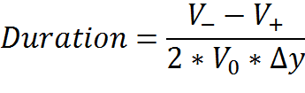

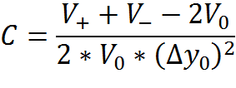

Effective Duration and Convexity
Effective Duration
%Price change = -Duration* *100.
Effective Convexity
%Price change = -Duration* *100 + C*

Slide 70
Cautions on Using duration
Traditional and Effective Durations (and Convexity) is not very different for straight bond.
Don’t use traditional duration/convexity for complex structured fixed-income securities whose cash-flows are not really “fixed” (i.e., bond with call option- embedded option bond, MBS,…).
Only use Duration to estimate price change for one-time immediate parallel shift in the yield curve.
Duration changes when time passes.

Slide 71
Duration of a portfolio of bonds
Duration of a portfolio of bonds = market value weighted average of duration of all bonds in that portfolio.
Example
Three bonds: 5, 15, 30 years to maturity; 10, 5, 14% coupon rates; $4000, $5000, $1000 par. Calculate the portfolio duration.
How will the portfolio market value change if the market rates for all maturities increase by 50 basic points?

Slide 72
Duration of a portfolio of bonds
Example
Three bonds: 5, 15, 30 years to maturity; 10, 5, 14% coupon rates; $4000, $5000, $1000 par. Calculate the portfolio duration.
How will the portfolio market value change if the market rates for all maturities increase by 50 basic points?

Slide 73
Duration-Based Hedging
If the market value of a firm’s assets and liabilities are affected by changes in interest rates, the firm’s equity value will also be affected.
The firm’s sensitivity to changes in interest rates can be measured by computing the duration of its assets and liabilities.

Slide 74
Duration-Based Hedging (cont'd)
Savings and Loans: An Example
When the durations of a firm’s assets and liabilities are significantly different, the firm has a duration mismatch.
This mismatch puts the S&L at risk if interest rates change significantly.

Slide 75
Duration-Based Hedging
Banks hold short-term deposits (checking and savings accounts, certificates of deposit, etc.) and make long-term loans (car loans, home mortgages, etc.).
Assets have longer duration (or maturity) than liabilities, and therefore are less liquid → duration mismatch
For banks an excessive maturity mismatch is desirable-especially when the yield curve is positively sloped and longer-term interest rates are well above short-term rates-because it increases profitability.
For the financial system, maturity transformation is undesirable because it could create a liquidity crisis threatening the existence of the bank and undermine the confidence in the banking system.

Slide 76
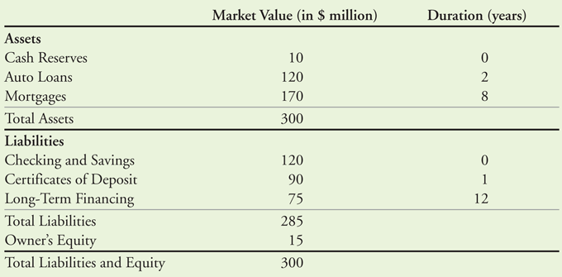
Market-Value Balance Sheet for Acorn Savings and Loan

Slide 77
Duration-Based Hedging (cont'd)
Savings and Loans: An Example
The duration of a portfolio of investments is the value-weighted average of the durations of each investment in the portfolio.
A portfolio of securities with market values A and B and durations D_{A} and D_{B}, respectively, has the following duration:

Slide 78
Duration-Based Hedging (cont'd)
Savings and Loans: An Example
The duration of Acorn’s assets is:
The duration of Acorn’s liabilities is:

Slide 79
Duration-Based Hedging (cont'd)
Savings and Loans: An Example
The duration of Acorn’s equity is calculated as:

Slide 80
Duration-Based Hedging (cont'd)
Savings and Loans: An Example
Therefore, if interest rates rise by 1%, the value of Acorn’s equity will fall by about 40%.
This decline in the value of equity will occur as a result of the value of Acorn’s assets decreasing by approximately $16 million, while the value of its liabilities decrease by only $9.9 million. Acorn’s market value of equity therefore declines by $6.1 million or 40.67%.
5.33% × $300 million = $16 million
3.47% × $285 million = $9.9 million
($16 million – $9.9million) ∕ $15 million = 40.67%

Slide 81
Duration-Based Hedging (cont'd)
Savings and Loans: An Example
To fully protect its equity from an overall increase or decrease in the level of interest rates, Acorn needs an equity duration of zero.
A portfolio with a zero duration is called a duration-neutral portfolio or an immunized portfolio, which means that for small interest rate fluctuations, the value of equity should remain unchanged.
Adjusting a portfolio to make its duration zero is referred to as immunizing the portfolio.

Slide 82
Duration-Based Hedging (cont'd)
Savings and Loans: An Example
To make its equity duration neutral, Acorn must reduce the duration of its assets or increase the duration of its liabilities.
The firm can lower the duration of its assets by selling some of its mortgages in exchange for cash.

Slide 83
Duration-Based Hedging (cont'd)
Savings and Loans: An Example
Acorn would like to reduce the duration of its equity from 40.7 to 0.
Because the duration of the mortgages will change from 8 to 0 if the S&L sells the mortgages for cash, Acorn must sell $76.3 million worth of mortgages.
(40.7 – 0) × 15 ∕ (8 – 0) = $76.3

Slide 84
Duration-Based Hedging (cont'd)
Savings and Loans: An Example
If it Acorn does so, the duration of its assets will decline to:
Thus the equity duration will fall to:

Slide 85
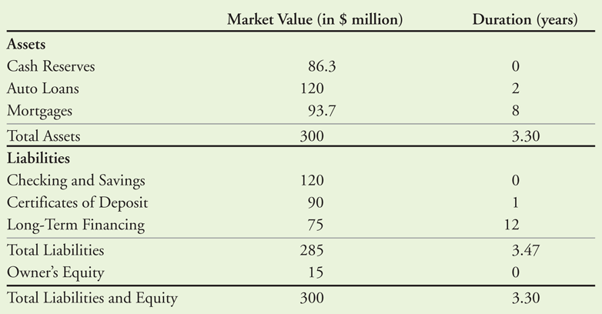
Table 30.5 Market-Value Balance Sheet for Acorn Savings and Loan After Immunization

Slide 86
Duration-Based Hedging (cont'd)
A Cautionary Note
Duration matching has some important limitations.
The duration of a portfolio depends on the current interest rate.
As interest rates change, the duration of the portfolio changes.
Maintaining a duration-neutral portfolio requires constant adjusting as interest rates change.

Slide 87
Silicon Valley Bank failure https://esg.gc.cuny.edu/2023/03/28/silicon-valley-bank-failure-explained/
A massive expansion of “hot money” deposits and investments in long-term securities
The year 2021 saw the raising of enormous capital for start-ups through Venture Capital firms. During the last four years, deposits in SVB increased dramatically from $50 billion in 2018 to almost 191 billion in 2021, before declining to 176 billion at end of 2022 (graph 2). This led to a threefold expansion in its total assets from $56 billion to $210 billion. The deposit growth rate was about 280%, compared with 30% for all the insured banks. SVB was flooded with deposits, primarily from start-up and tech companies concentrating in a unique client/deposit base and mainly uninsured deposits, and thus exposing itself to concentration risk.

Slide 88
Silicon Valley Bank failure
SVB invested mainly in longer-term, higher yielding government and government agency mortgage back securities, like Fannie Mae and Freddie Mac.
Investments in securities are typically classified in the balance sheet, for accounting purposes, as a) held-to-maturity and b) available-for-sale.
In 2022, SVB had placed $91.3 billion under the first category and $28.5 billion in the second, totaling around $120 billion (table 1). But due to the interest rates hike, the fair value of the portfolio went down to $102 billion, causing a hefty unrealized loss of $18 billion at the end of 2022.
Typically, the decline in value is not a major issue, unless due to liquidity problems the bank is forced to sell part of the portfolio. The unrealized loss would have been much lower if SVB had invested in shorter maturities, like into two-year notes or less, since longer-term securities are more sensitive and more exposed to rising interest rate.

Slide 89
Silicon Valley Bank failure
The impact of higher interest rates, adverse market conditions and the Bank Run
Associated with the rise in interest rate was a weakening of the economic environment and as market conditions worsened and firms-mainly start-ups- required more working capital (cash), deposit withdrawals escalated.
The excessive and increasing reliance on these “hot money” type of deposits, in the absence of other long-term funding sources and a means of keeping deposits intact, like a revolving credit line facility, formed a potentially fragile and insolvent bank environment.
And informed depositors are more likely to run away with the first sign of trouble. In an attempt to meet depositors’ claims for cash, and improve the bank’s liquidity profile, SVB was forced to sell $21 billion from the $26 billion of its available-for-sale securities portfolio, and, given the inversion of the yield curve, it had to incur a vast loss of $2 billion. Following this sale and to strengthen its balance sheet, SVB announced an unsuccessful sale of $2.25 billion worth of stock shares ($1.25 billion of common stock to the public, $0.5 billion to the General Atlantic firm, and $0.5 billion from a convertible preferred stock offering).
The sequence of these events triggered one of the biggest runs in history, with more depositors racing to withdraw their capital. The run heralded SVB’s failure: as the value of the stock plunged and after trading was halted, regulators placed the bank under receivership and created a bridge bank transferring all insured deposits.

Slide 90
Other risk of bonds
Reinvestment Risk
Contraction risk.
Extension risk.
Credit Risk
Default risk.
Credit spread risk.
Downgrade risk.

Slide 91
Reinvestment Risk
The risk that CFs will have to be reinvested in the future at lower rates, reducing income.
Illustration: Suppose you just won $500,000 playing the lottery. You’ll invest the money and live off the interest. You buy a 1-year bond with a YTM of 10%.

Slide 92
Reinvestment Risk
Year 1 income = $50,000. At year-end get back $500,000 to reinvest.
If rates fall to 3%, income will drop from $50,000 to $15,000. Had you bought 30-year bonds, income would have remained constant.

Slide 93
Reinvestment Risk
Long-term bonds: High interest rate risk, low reinvestment rate risk.
Short-term bonds: Low interest rate risk, high reinvestment rate risk.
Low coupon bonds have less reinvestment rate risk but more price risk than high coupon bonds

Slide 94
Other risk of bonds
Inflation Risk
Exchange Rate Risk
Liquidity Risk

Slide 95
COPORARE BOND MARKETS
Çelik, S., G. Demirtaş and M. Isaksson (2019), “Corporate Bond Markets in a Time of Unconventional Monetary Policy”, OECD Capital Market Series, Paris, www.oecd.org/corporate/Corporate-Bond-Markets-in-a-Time-of-Unconventional-Monetary-Policy.htm.

Slide 96
End of Chapter 4

